Slide 1
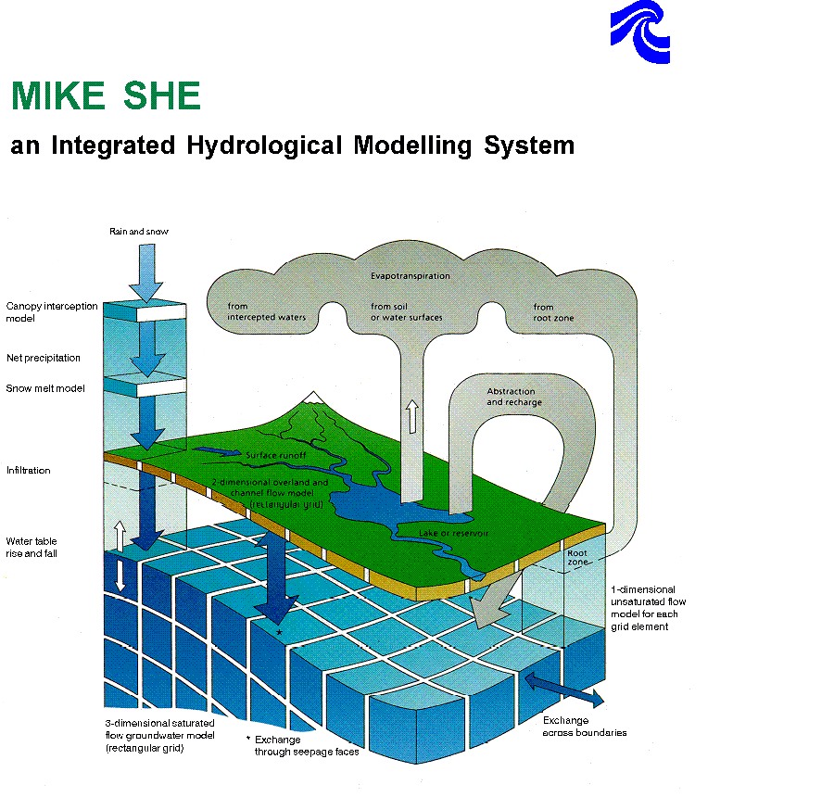
Vegetation
Snow pack
Surface water
Unsaturated Zone
Saturated Zone

Slide 2
MIKE SHE PP
Graphical editing functionalities
Plotting facilities
Various utility programs for data manipulation
Water balance program
Interpolation program
Sub-model module
Geological pre-processor

Slide 3
MIKE SHE WM
3-D Boussinesq equation for saturated flow
1-D Richards' equation for unsaturated flow
2-D Saint Venant's equation (diffusive wave approximation) for overland flow
1-D river model (diffusive wave approximation)
Evapotranspiration/Interception
Snowmelt
Sources/sinks, time variable head boundaries, and other types of boundary conditions
River/aquifer exchange
Complete coupling between the individual components

Slide 4
MIKE SHE WM - Components
ET Interception/Evapotranspiration
  Interception of rainfall by the canopy
  Drainage from the canopy
  Evaporation from the canopy surface
  Evaporation from the soil surface
  Uptake of water by plant roots and its transpiration
OC Overland and Channel flow
  Surface runoff
  Routing in rivers
UZ Unsaturated Zone flow
  Infiltration
  Moisture distribution
SZ Saturated Zone flow
  3D groundwater flow
  Exchange with boundaries

